Slide 1
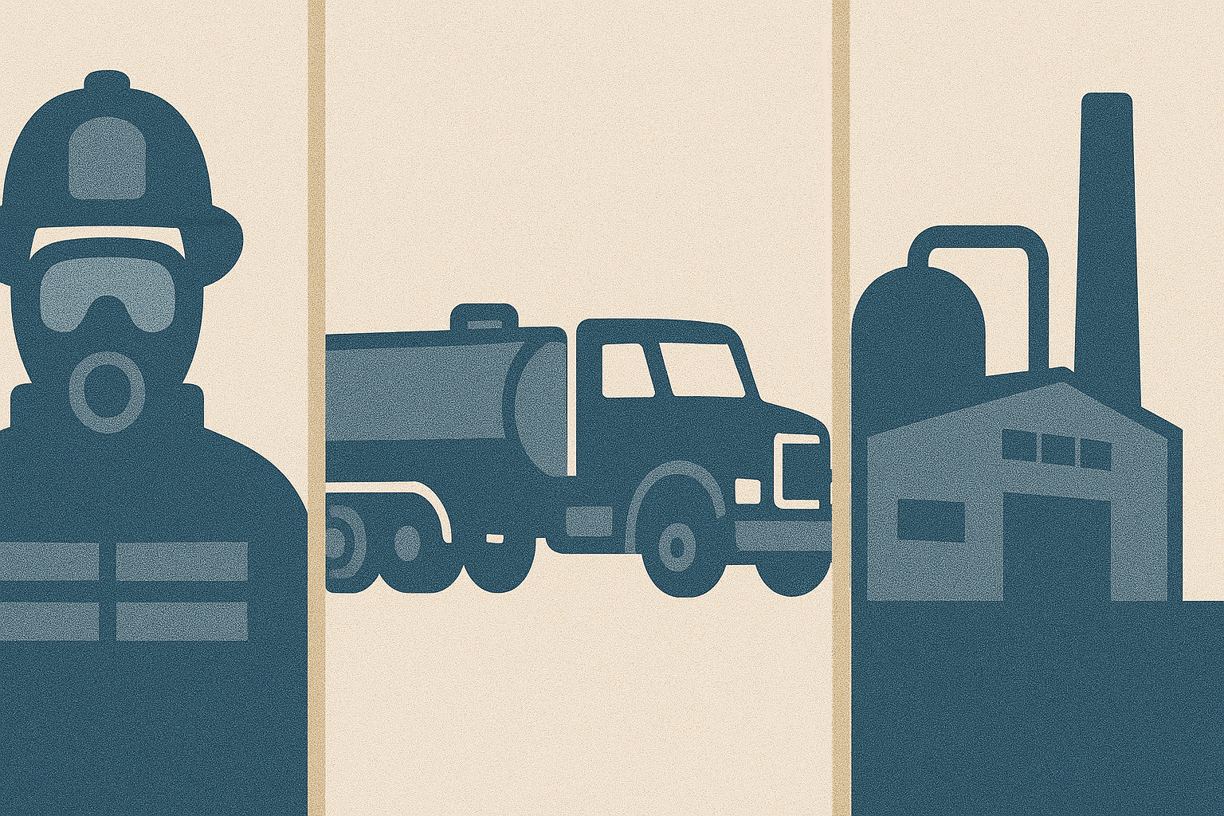
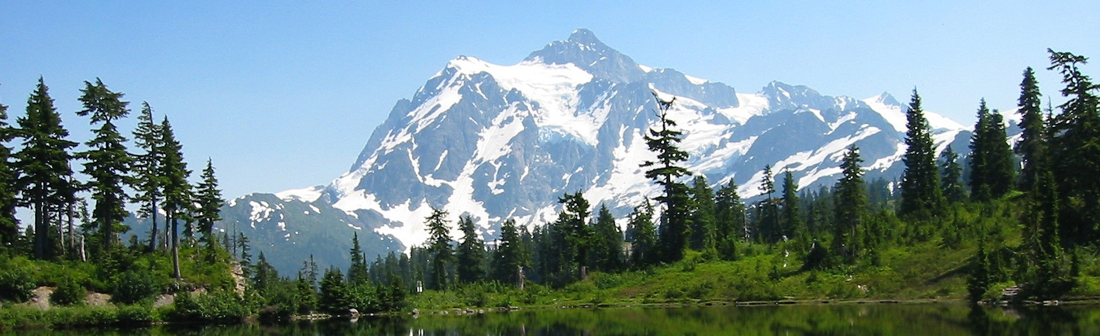
Ecology’s AFFF Disposal Program
Sean Smith
October 14, 2025
Notes:
Talk about Ecology’s AFFF disposal program timeline
Our EIS process
The disposal options considered
The program’s launch and process
Other stockpiles
And Other AFFF work

Slide 2
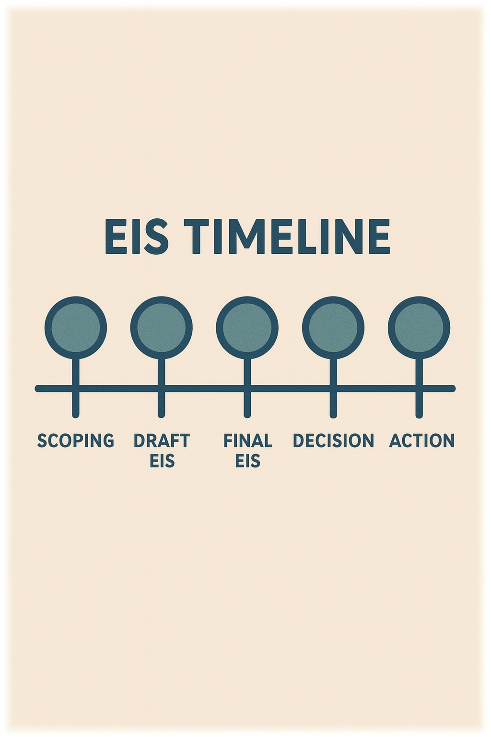
Timeline
Legislature Appropriates Disposal Funds July 2019
Determination of Significance January 2021
Public Scoping 2021
DEIS Launch November 2021
DEIS Public Input
Tribal Forums September 2022
Public Comment December 2023
Notes:
Story begins back in 2019

Slide 3
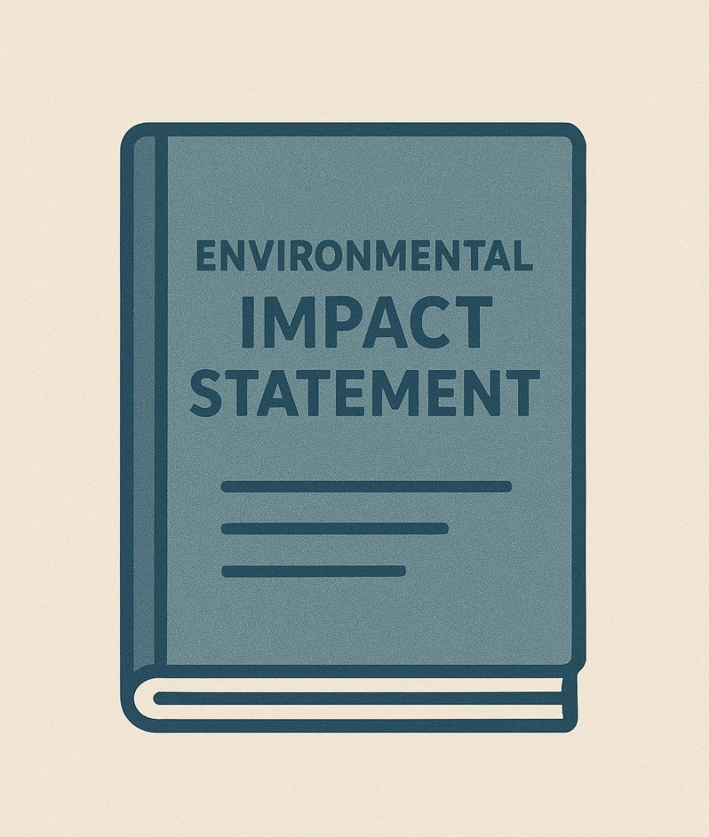
AFFF Collection Program (EIS)
Finalized a review of the environmental and public health impacts associated with the disposal PFAS containing foam. October 2024
Five Disposal Options (Landfilling, Incineration, Deep-Well Injection, Approved Hold In Place, No-Action)
Notes:
https://ecology.wa.gov/waste-toxics/reducing-toxic-chemicals/product-replacement-program/afff-disposal/afff-eis

Slide 4
Disposal Option Assessments
Criteria | Incineration | Landfilling | Deep Well | Hold/Place | No-Action
Protectiveness | Yes (PFAS Destruction) | Yes (PFAS Sequestration) | Yes (PFAS Sequestration) | Yes (PFAS Destruction) | No
Time to Imp | 3-6 months | 12 months | 12 months | 24 to 60 months or more | Immediate
Health and Env | Minimal | Minimal | Minimal | Minimal | Minimal
Transport | 650 to 1000 miles | 450 to 750 miles | 1400 to 1900 miles | Unknown | None
Public Input | Support and Oppose | Support and Oppose | Support and Oppose | Support and Oppose | Oppose
EJ | Not Significant | Not Significant | Not Significant | Not Significant | Not Significant
Tribal | Mitigation Needed | Mitigation Needed | Mitigation Needed | Mitigation Needed | None
Permitting, etc. | No | Yes | Yes | Yes | No
Notes:
Criteria Used to Review Options
Here is a table of the disposal options and what was found related to each criteria.
First, all alternatives except the No action were found to be protective of the environment by either destroying or safely sequestering the PFAS mass.
As to the time needed to implement, no-action is the quickest, followed by incineration, then landfilling and Deep Wells, and finally Hold in Place.
All alternatives were found to have minimal impacts upon public health and the environment.
The transport distances ranged from none under the No-action alternative to 450/750 miles for landfilling, 650/1000 for incineration, 1400/1900 Deep Well and unknown for Hold in Place.
As stated, before the public provided comments opposing all alternatives. The public also supported every alternatives but the no-action.
The EJ analysis found none of the alternatives produced disproportionate impacts to people of color or low-income communities.
All but the no-action alternative produced impacts upon tribal resources that will need to be mitigated.
Incineration and the No-action alternatives do not require Ecology to draft additional permits, rules, or contracts. Meanwhile, Landfilling and Deep-Well will require an RFQQ, while the Hold in Place would also require an RFQQ, and perhaps a new permit or rule.

Slide 5
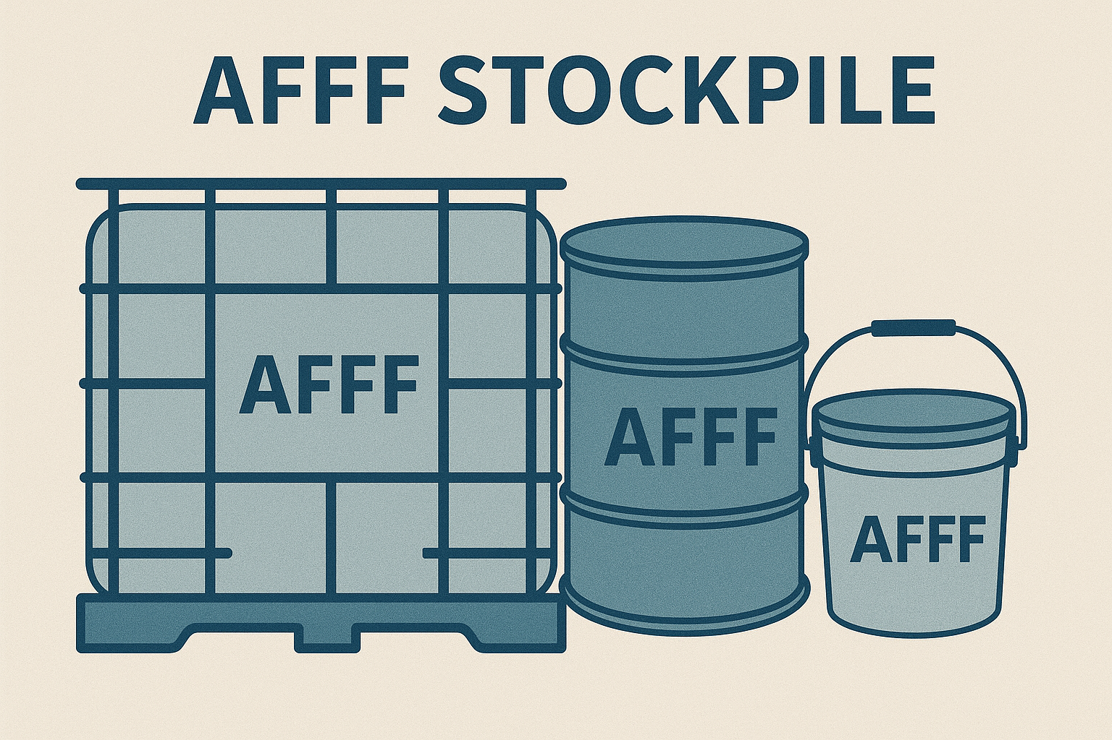
Program Launch
Launched Program Sept. 2025
77 Departments Participating
More than 32,000 gal
CRO ~ 14 Departments 7,232 gal
ERO ~ 11 Departments 3,365 gal
NWRO ~ 33 Departments 15, 209 gal
SWRO ~ 23 Departments 6,502 gal

Slide 6
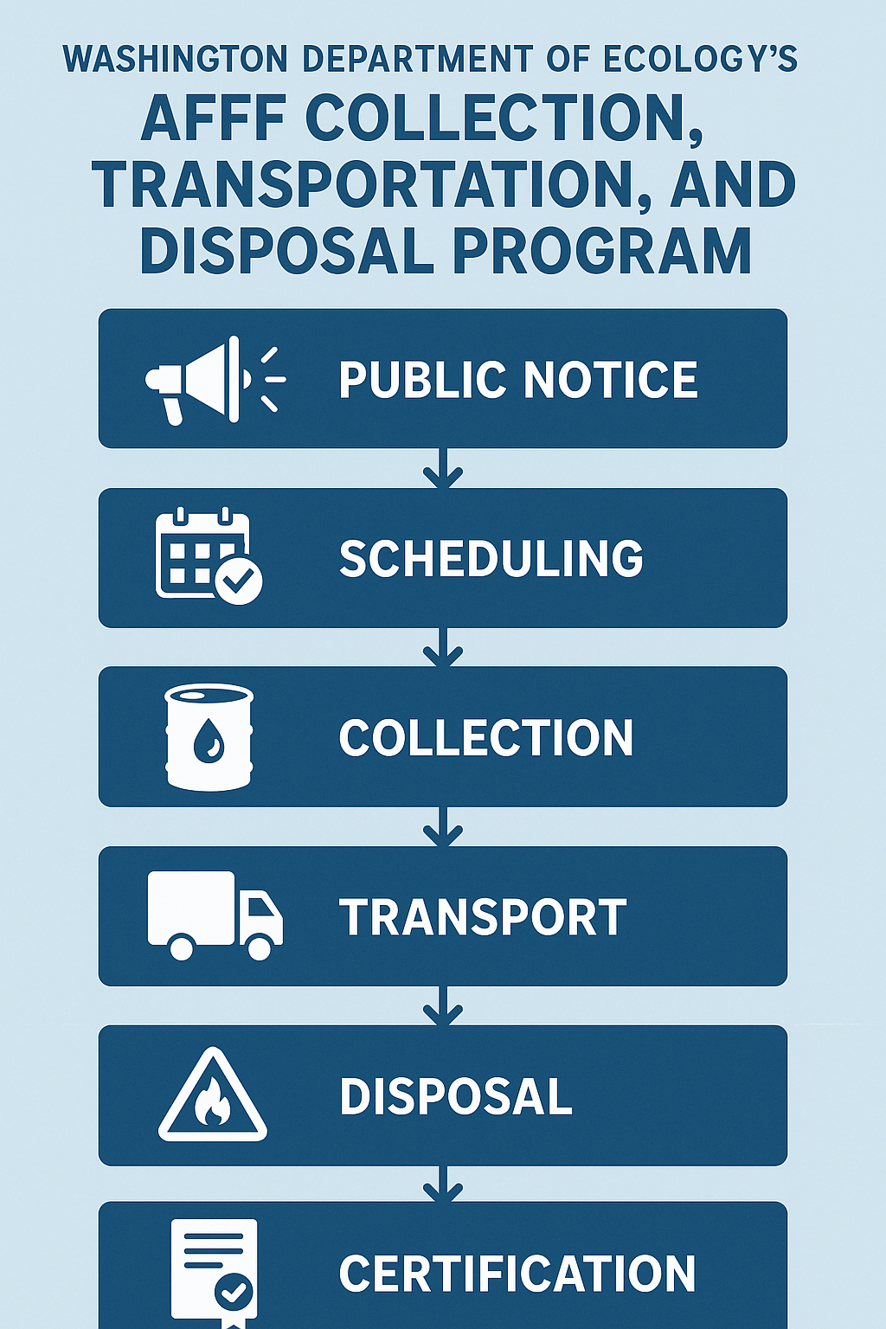
Here
Notes:
Implementation: Collection Process

Slide 7
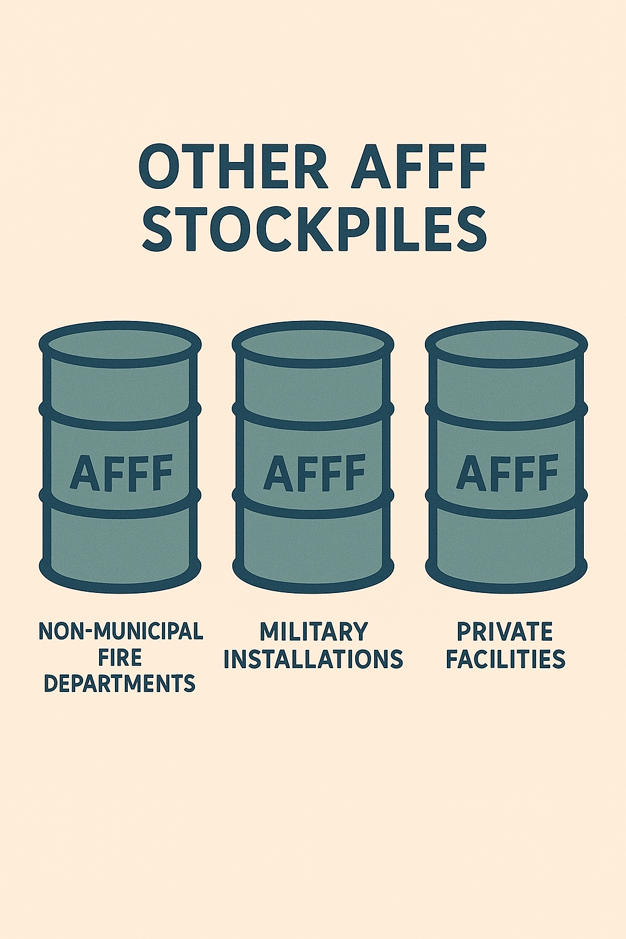
Other Foam Stockpiles
Non-Municipal Fire Departments
Military Installations
Private Facilities
Notes:
There are several AFFF foam stockpiles that are not eligible for Ecology’s AFFF disposal program. Those include stockpiles owned or managed by non-municipal fire departments, military bases, or private facilities. These stockpiles are likely many times larger than what is being collected under our program.

Slide 8
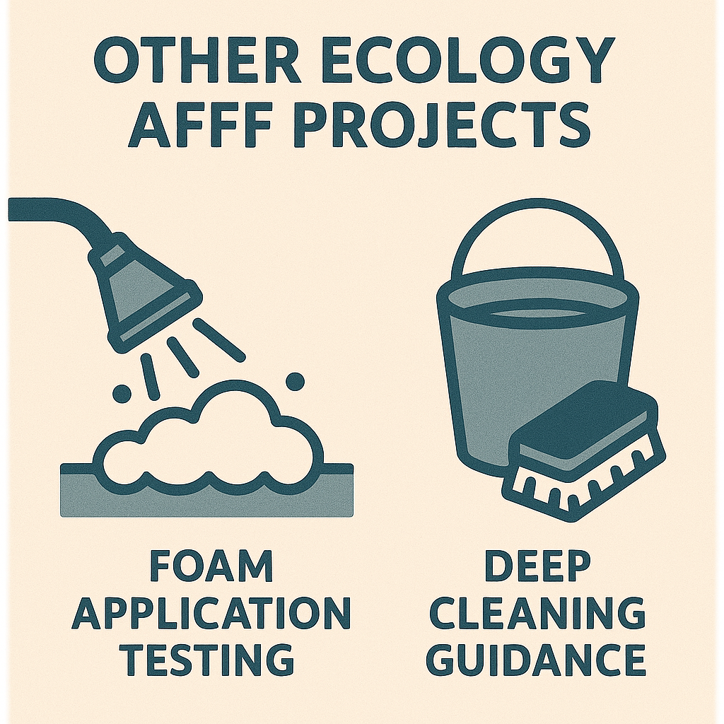
Other AFFF projects
Foam Application Testing
Deep Cleaning

Slide 9
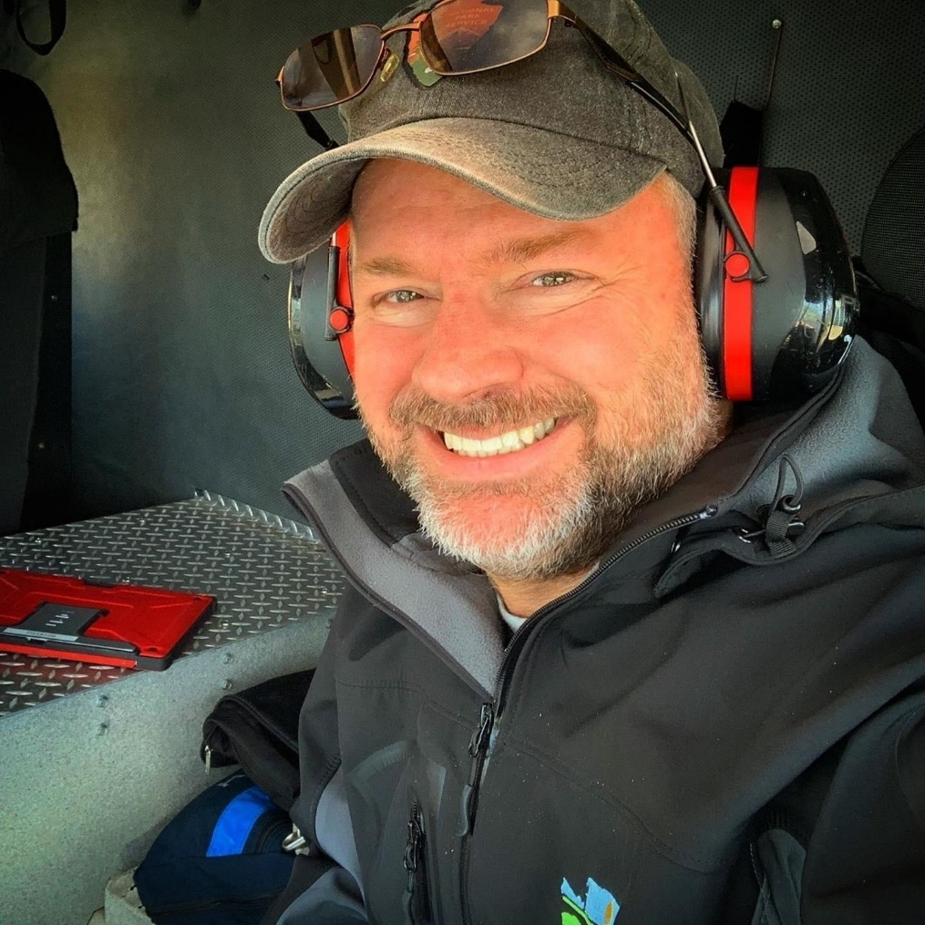
Thank You
For more information on Ecology’s AFFF disposal program or our other product replacement work please contact me at:
Sean Smith, M.S.
Department of Ecology
Northwest Regional Office
P.O. Box 330316
Shoreline, WA 98133
425-324-0328 | Sean.Smith@ecy.wa.gov
To learn more about our work please visit:
ecology.wa.gov/ToxicsInFirefighting
Notes:
Here is my contact information. As well as a link to our Toxics in Firefighting website.
Thanks for your attention.

